Slide 1
Outline
Industry need and trends
Introducing the Maximo Application Suite
Value Proposition – IBM Maximo Application Suite (MAS) Overview and Deployment Options
How to Solution MAS – Details of various aspects to consider when solutioning MAS
Suite commercial aspects
Demo: MAS Setup -- Watch it in action
Notes:
What’s changing Across industries…what are the challenges with Enterprise Asset Management today

Slide 2

The operating model in asset intensive industries is changing
Drone Inspection
15%-50%
Reduced Operational Cost
Real time remote monitoring
Predictive failure model
5%-10%
Increased Up time & Availability
Sensors
Up to 15%
Increased Asset Life
SCADA / Embedded System
Digital Twin
Notes:
The asset of the future includes several integral parts, as outlined on the slide, exponentially increasing the efficiency and transparency of your operations.
Sensors capture data, which are then housed in the cloud which then flow into Real Time Monitoring
Real Time Monitoring allows your to transparently see what your assets are doing, and how they are performing 24/7. This flows right into the Predictive Failure Model
Taking this data from sensors and RT Monitoring, Machine learning can develop a high grade of accuracy to predict failures and understand asset criticality, tying directly into MRO Inventory optimization and supply chain needs
Autonomous driver capabilities leverages sensors and onboard (edge) compute to decrease operational and safety risks, while optimizing productivity automatically
A fully functional digital twin is the result of all of this. It is a digital representation not only of your individual assets/equipment, but of your entire system and process. Digital twins allow you to effectively model operations, monitor every aspect of your operation, and optimize the output of your system. Digital twin will also enable better information sharing between parties, minimizing downtime, and creating effective communication amongst asset OEMs, owners, operators, and mainteners.

Slide 3
Outline
Industry need and trends
Introducing the Maximo Application Suite
Value Proposition – IBM Maximo Application Suite (MAS) Overview and Deployment Options
How to Solution MAS – Details of various aspects to consider when solutioning MAS
Suite commercial aspects
Demo: MAS Setup -- Watch it in action
Notes:
What’s changing Across industries…what are the challenges with Enterprise Asset Management today

Slide 4
Introducing the next generation solution for Intelligent Asset Management, Maintenance and Operations Maximo Application Suite
Maximo 8.x

Slide 5
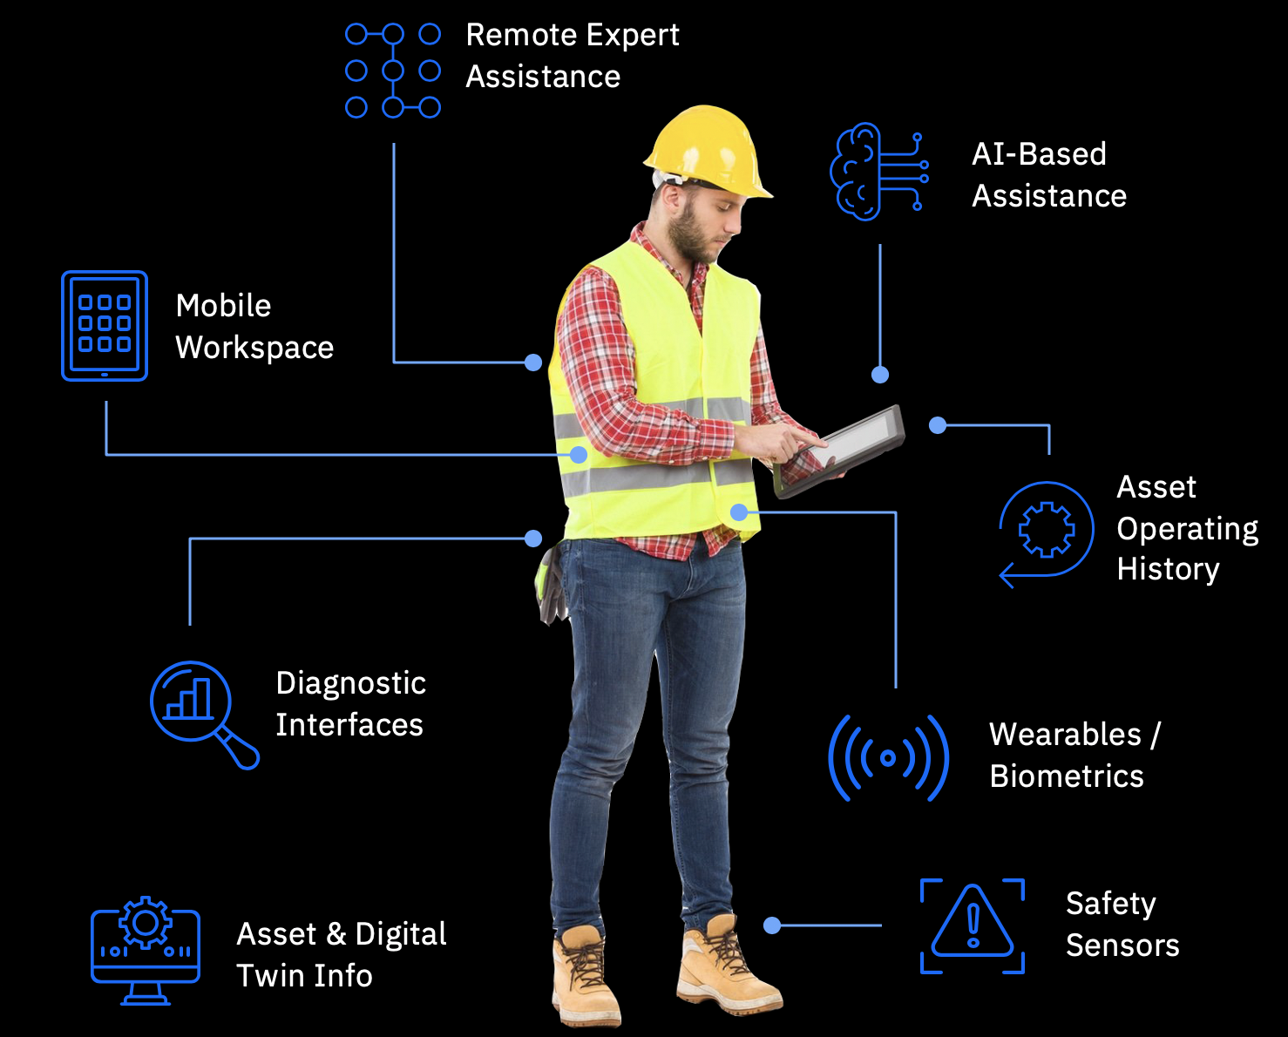
Reimagine operations with AI and predictive maintenance
New insights from assets
New ways of working
AI Anomaly or Alert
Generate Work Queue
Visual Inspection
Asset Health Score
Maintenance History
Predicted Failure
Notes:
Embedding AI across. Closed loop model
If you think about the digital transformation that’s occurring, combination of two gives you that. increased productivity and operational uptime. To achieve a complete view of asset lifecycle management, clients need to capture and analyze data from today’s intelligent assets in order to understand the full spectrum of preventive, predictive and prescriptive maintenance actions needed.
Al infused in existing business process

Slide 6
Journey to Predict
Visual Inspection
Predict
Visual anomaly detection
Use data to predict failures
Monitor
Health
Manage and detect anomalies
Manage
Health
Manage
Understand and manage maintenance
Digital Twin
1-click download
6
Notes:
Enabler across the entire journey
Gathering data and building your way to predict…

Slide 7
Outline
Industry need and trends
Introducing the Maximo Application Suite
Value Proposition – IBM Maximo Application Suite (MAS) Overview and Deployment Options
How to Solution MAS – Details of various aspects to consider when solutioning MAS
Suite commercial aspects
Demo: MAS Setup -- Watch it in action
Notes:
What’s changing Across industries…what are the challenges with Enterprise Asset Management today

Slide 8


Built to scale your digital transformation journey
Integrated Solution
Simplified Licensing
Multi-Cloud Deployment
Notes:
Suite is an existing concept…1 contract 1 pricing model and use any

Slide 9
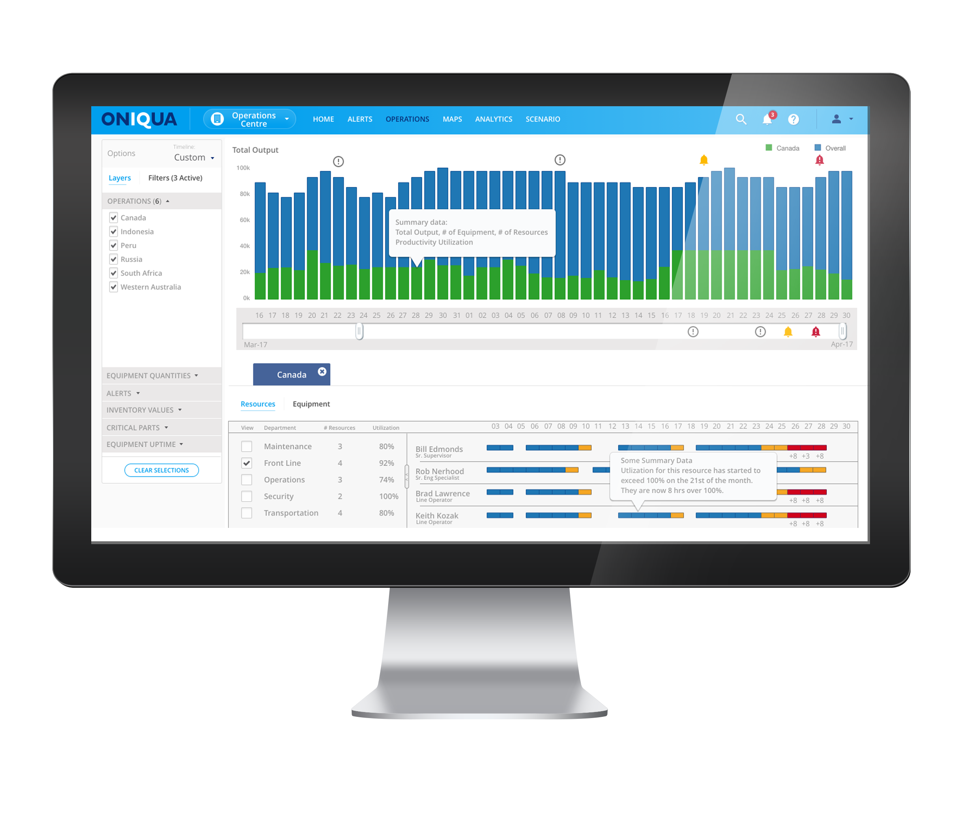
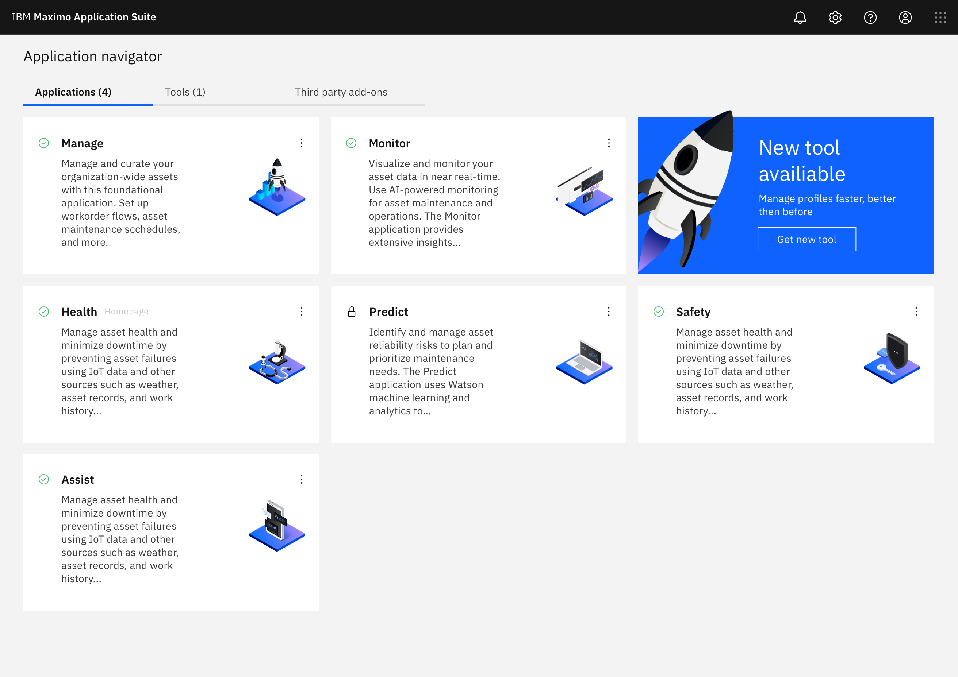
Start anywhere and scale your digital transformation journey
Integrated Suite of Applications
Notice: IBM’s statements regarding its plans, directions, and intent are subject to change or withdrawal at IBM’s sole discretion. Information regarding potential future products is intended to outline our general product direction and it should not be relied on in making a purchasing decision. The information mentioned regarding potential future products is not a commitment, promise, or legal obligation to deliver any material, code or functionality. Information about potential future products may not be incorporated into any contract. The development, release, and timing of any future features or functionality described for our products remains at our sole discretion.
9
Notes:
Single integrated platform, Enhanced data sharing, Easy to try new applications
Modern componentized architecture built for scale and availability
Notes: Data sharing focus; single source of data, Value add vs not, Focus on problems not data plumbing, You can capture everything faster, more effectively, resilient decision making in your Operations
Enhanced user experience with single sign-on, increased data sharing, and application integration
Everything is integrated and available: no additional procurement/installation for new apps

Slide 10
Maximo Application Suite Benefits
-
Single license
One entitlement to entire Suite
Simplified Licensing and Usage
Flexible consumption
Sharing of license through concurrent users
Simplified usage
Access any app without additional provisioning
10
Notes:
Example 1: Core Maximo users will be a basic user type and will be able to use a single user license to access any of the applications (roles) that are support basic user type (majority)
Example 2: Technicians will user a Limited user type
====
Simplified licensing structure: Through committed term licenses with single entitlement for all apps
Shared pool of points: Tokens purchased can be used across applications, shift usage across apps as needed
Get more from your EAM Investment: Start with what you need and pay only for what you use
Provides increased flexibility and lower cost of entry
A shared pool of points leveraged by all Suite applications makes it easier to try new capabilities
A unified account to access and navigate across the apps
Monitor and track usage across
Get more of your EAM
We are delivering it using a new simplified licensing model where you purchase user-based seats to the suite with the ability to leverage ANY of the solutions in the suite. That is correct, you can access any of the solutions in the suite.

Slide 11
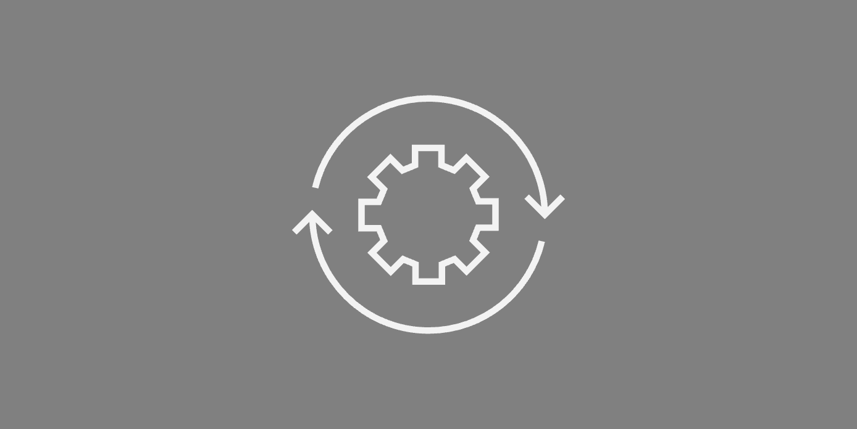









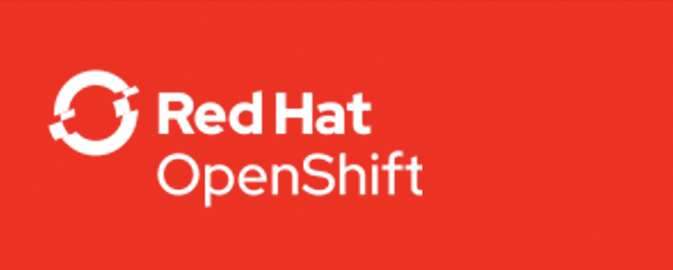
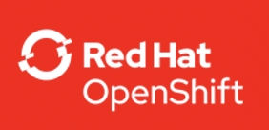
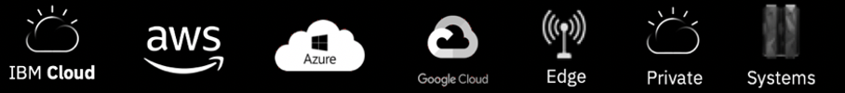
Maximo Application Suite Benefits
Suite Applications
Manage
Intelligent asset management
Scheduler
Schedule work and resources
Monitor
Monitor and detect anomalies
Health
360-degree view of assets
Predict
Predictive failures
Multi-Cloud Deployment
Mobile
Technician work execution
Assist Prescriptive assistance
Safety
Actionable insights for safety
Visual Inspection
Visual anomaly detection
IBM Cloud Pak for Data | IBM Watson Studio | IBM Watson ML | DB2
Infrastructure Independent
Common Operating Environment
Notice: IBM’s statements regarding its plans, directions, and intent are subject to change or withdrawal at IBM’s sole discretion. Information regarding potential future products is intended to outline our general product direction and it should not be relied on in making a purchasing decision. The information mentioned regarding potential future products is not a commitment, promise, or legal obligation to deliver any material, code or functionality. Information about potential future products may not be incorporated into any contract. The development, release, and timing of any future features or functionality described for our products remains at our sole discretion.
11
Notes:
Built on the Red Hat OpenShift Container Platform: for optimized scale and availability on on-premises, private and public clouds, or hybrid environments
Customer managed: Purchase MAS and deploy in the environment of your choice
IBM Managed: Purchase MAS and hosting, and let IBM’s trusted team take care of everything for you
Easy to install
Point to RHOS, Cloud Pak slide in backup, make it meaningful to Maximo customers (Other benefits)
All of these solutions are being delivered together in what we are calling Maximo 8.0 run on the IBM cloud powered by OpenShift. It operates with your existing Maximo installation.

Slide 12
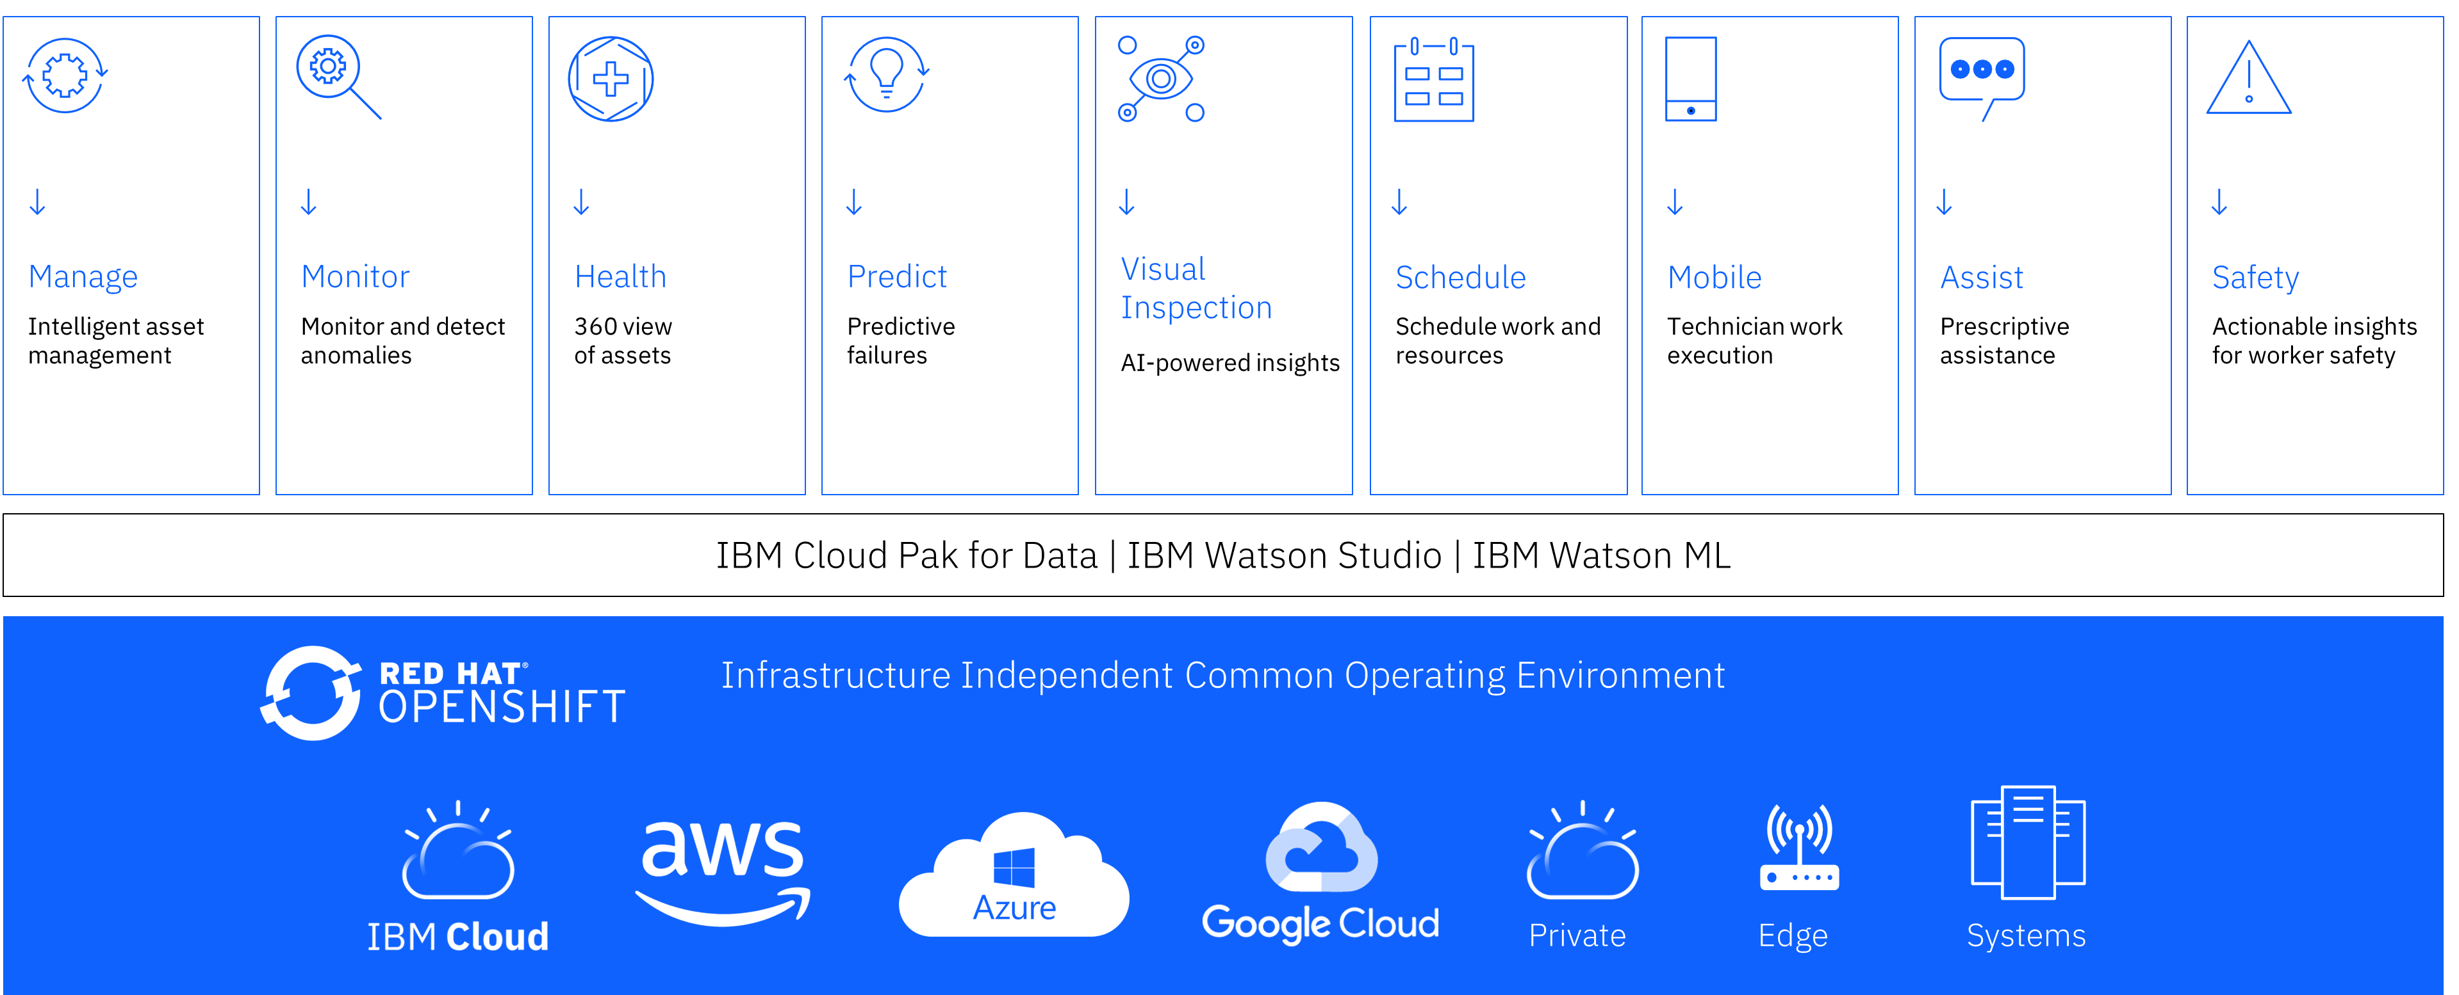

Maximo Application Suite
Multi-Cloud Deployment

Slide 13
Outline
Industry need and trends
Introducing the Maximo Application Suite
Value Proposition – IBM Maximo Application Suite (MAS) Overview and Deployment Options
How to Solution MAS – Details of various aspects to consider when solutioning MAS
Suite commercial aspects
Demo: MAS Setup -- Watch it in action
Notes:
What’s changing Across industries…what are the challenges with Enterprise Asset Management today

Slide 14
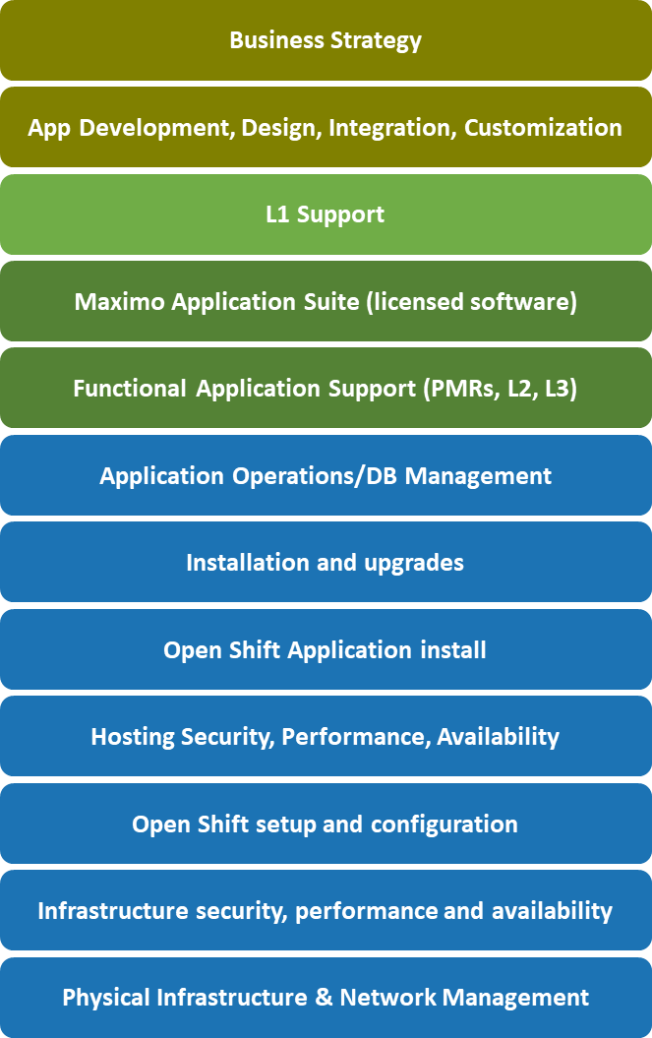
IBM Managed Offerings : MAS
MAS Dedicated or SaaS operates the complete stack
x
License or subscription
Purchasing infrastructure from Cloud providers only covers the IaaS below. Initial set up takes you to PaaS.
MAS
SaaS
MAS
Dedicated
Platform as a Service (PaaS)
Infrastructure as a Service (IaaS)

Slide 15
MAS Deployment Options
Deployment | Availability | Procure | Provision & Operate | Client Benefits
On Premise Customer Managed | Now | Client purchases MAS from IBM Client provides infrastructure | Client provisions, manages, and operates full stack | Maximum operational flexibility
Hyperscalers Customer Managed | Now AWS 1Q22 Azure 2Q22 | BYOL Client purchases software from IBM and infrastructure from Hyperscalers | Client runs IBM-provided automation scripts to deploy MAS on Hyperscalers’ cloud Client manages and operates both software and infrastructure | Simplifies procurement and deployment Allows client to select their Hyperscalers Flexibility for clients to manage and operate their environment
 | Now AWS 3Q22 Azure 4Q22 | Paid (Marketplace listing) Client purchases software and infrastructure from Hyperscalers
SaaS IBM Managed | Now AWS 3Q22 | Client purchase single part (includes software, infrastructure, and operations) from either std IBM sales/channels or AWS Marketplace | IBM provisions, manages, and operates Client’s MAS environment on AWS Cloud using IBM’s AWS cloud account | Reduced time-to-value Reduced operational costs Allows clients to focus on business priorities
Dedicated (formerly Managed Service) IBM Managed | Now IBM 2020 AWS 2023 | Client purchases software and managed service (including infrastructure) from IBM | IBM provisions, manages, and operates Client’s MAS environment on IBM Cloud or AWS in an IBM owned account Currently has two flavors Shared cluster (legacy – IBM Cloud only) Dedicated cluster (new) | Simplifies deployment and operations Provides more flexibility, than SaaS, to customize environment Provides more operational flexibility than SaaS

Slide 16
MAS Solutioning Decision Tree
Start
New MAS 8.x install
N
Move Maximo 7.x to MAS 8.x*
Number of environments
Database migration
N
MAS Migration
Y
Y
DB Migration**
Data residency requirement
Client prefers non IBM Cloud or on-prem
>99.9% SLA required
Flexibility to customize
N
N
N
N
MAS SaaS
Y
Y
Y
Y
MAS Software
MAS SaaS Dedicated
Deployment Options
Deployment Options
HA MZR
HA multi-region
AWS
IBM Cloud
Azure (TBD)*

Slide 17
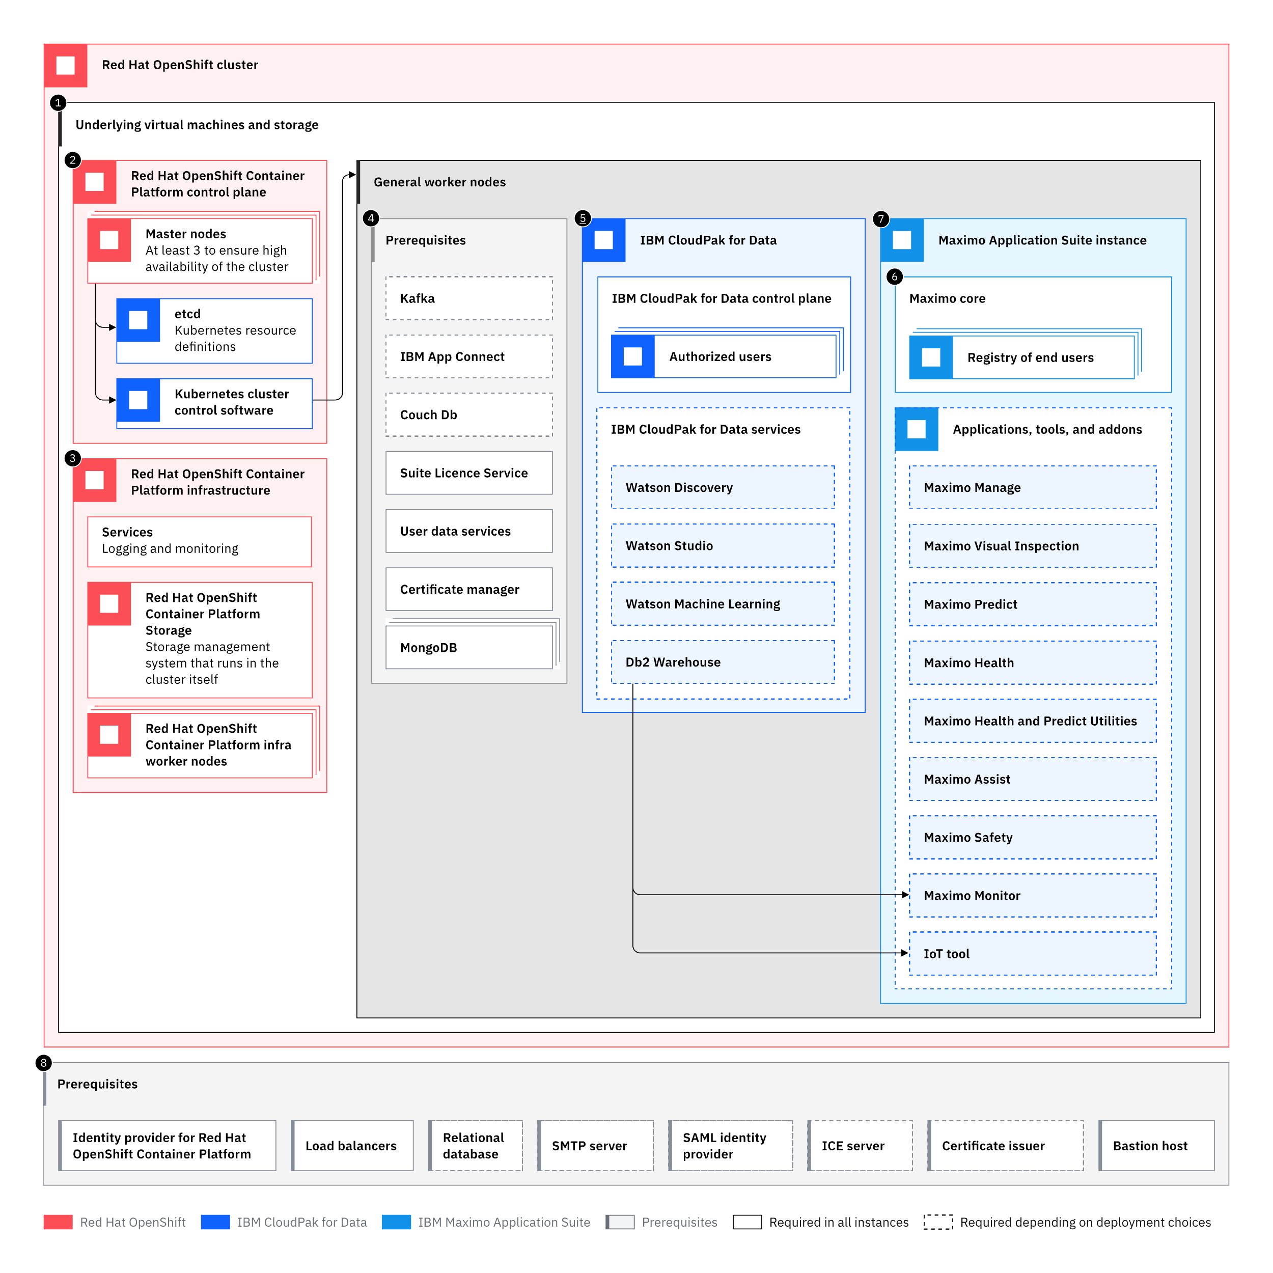
MAS Deployment on OpenShift – Typical Infrastructure Deployment Overview
Virtual Machines and Storage (IaaS, Paas such as ROKS)
RH OpenShift Container Platform Control Pane
RH OpenShift Container Platform Infrastructure
Maximo Application Suite Prerequisites
Cloud Pak for Data
MAS instance Suite Core
MAS Applications, industry solutions, addons and tools.

Slide 18
Changes: Containerization, Built-in Liberty, OpenShift
Maximo Application
Maximo Application
Maximo Application
Maximo Application
Containerization
Light weight
Fast
Portable
Consistent
Liberty
Liberty
Websphere JVM
Websphere JVM
Container
Container
Websphere Network Deployment
Container Runtime
Operating System
Operating System
Infrastructure Machines
Infrastructure Machines
OpenShift
Container orchestration/scheduling
Load management
Routing
Config management
Security
Monitoring
OpenShift Control plane
Maximo pod
Maximo pod
Maximo pod
Maximo pod
OpenShift
Master Node
Master Node
Worker Node
Worker Node
Master Node

Slide 19
Changes: Images are deliverables
Maximo 7.6.x
Manage
Maximo bin zip
Base image
Group sync Image
Maximo Install Dir
Industry solution zip
IS extension image
Industry solution zip
IS extension image
Industry solution zip
IS extension image
User sync Image
IS files
Installer/configuration manager
Liberty base image
Monitoring Image
Operator Images
Operator Images
PPA/Fix central
IBM entitled Registry

Slide 20
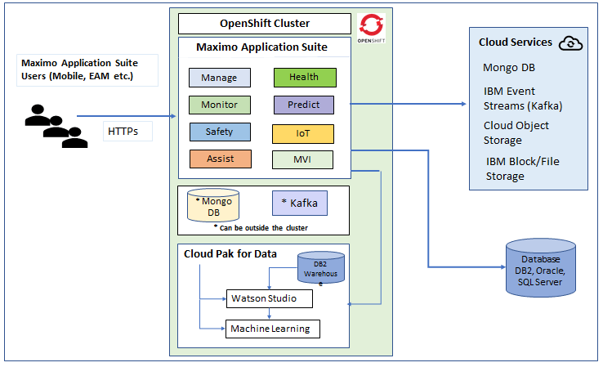
MAS Architecture

Slide 21
Outline
Industry need and trends
Introducing the Maximo Application Suite
Value Proposition – IBM Maximo Application Suite (MAS) Overview and Deployment Options
How to Solution MAS – Details of various aspects to consider when solutioning MAS
Suite commercial aspects
Demo: MAS Setup -- Watch it in action
Notes:
What’s changing Across industries…what are the challenges with Enterprise Asset Management today

Slide 22
MAS License model – User has access to use all products in the level
Premium Concurrent User – 15 AppPoints
Manage Industry Solutions
Predict
Visual Inspection
Trans.
Nuclear
Utilities
Oil & Gas
Aviation
Civil Infras.
ACM
MSP
HS&E
Base Concurrent User – 10 AppPoints
Manage (full access)
Scheduler/Plus
Health
Spatial
Linear
Calibration
Limited Concurrent User – 5 AppPoints
Manage/Ind. Solutions (3 modules)
Manage Mobile user
(Anywhere/3rd party)
Monitor
Spatial
Linear
Calibration
Install – 1 AppPoint (x multiplier)
Manage ERP Adapter for SAP/Oracle (x80)
Manage
Spatial (x20)
Visual Inspection
(x45)

Slide 23
MAS - Sizing
IBM Technology tech sales or GSI Lab Subject Matter experts can provide the sizing for MAS components based on the client requirements.
The team mostly use the “IBM MAS Sizing Calculator” to produce sizing. CSC can use the sizing provided as an input to derive the OpenShift Cluster Architecture and Sizing.
Key Notes:
It is not clear if the sizing includes additional infrastructure required to implement HA for DB2 warehouse, Kafka and Mongo DB.
MAS provides a concept of Workspaces which can be utilized to provide multiple environments like more than one Dev, SIT or UAT environments. It is recommended to use separate OpenShift Cluster for Non-Production and Production.
MAS - Licensing
https://www.ibm.com/support/customer/csol/terms/?id=L-DPUD-5BMY6P&lc=en#detail-document

Slide 24
Reference Links
Maximo IBM Documentation
Maximo Sizing Calculator
Maximo Managed Services Offering Documentation
Maximo Playbook
Customer references in seismic
https://ibm.seismic.com/Link/Content/DCqgjPqQqF6CB89XHQW9MQBMVDP3
MAS docs
https://www.ibm.com/docs/en/maximo-manage/continuous-delivery?topic=upgrading-from-maximo-enterprise-asset-management-maximo-manage
Migration Considerations
https://www.mavenasset.com/move-forward-to-mas/
https://www.ibm.com/docs/en/maximo-manage/continuous-delivery?topic=upgrading-from-maximo-enterprise-asset-management-maximo-manage

Slide 25
FAQs
Do you have any customer references?
https://ibm.seismic.com/Link/Content/DCqgjPqQqF6CB89XHQW9MQBMVDP3
We are currently using Maximo 7.2. Can we continue using it?
IBM has officially announced End of Service for Maximo 7.6.1.2 on September 30, 2025.
You will have to upgrade to Maximo 7.6.1.2 and then move over to Maximo Application Suite 8.x.
What is MAS?
Previously known as Maximo® Enterprise Asset Management (EAM), Maximo Manage is part of IBM® Maximo Application Suite (MAS) and has been enhanced with new features.
Maximo Asset Management 7.6.0.10 or 7.6.1.2 or later is required before you upgrade to Maximo Manage.
How long does it take to move from Maximo 7.x to MAS 8.x?
It depends but roughly anywhere from x to y weeks
https://www.mavenasset.com/move-forward-to-mas/
Does MAS only run in the cloud?
No, MAS can also be installed on-premises.
Is MAS supported on all hyperscalers?
MAS runs on IBM Cloud, AWS, Azure

Slide 26
Outline
Industry need and trends
Introducing the Maximo Application Suite
Value Proposition – IBM Maximo Application Suite (MAS) Overview and Deployment Options
How to Solution MAS – Details of various aspects to consider when solutioning MAS
Demo: MAS Setup -- Watch it in action
Notes:
What’s changing Across industries…what are the challenges with Enterprise Asset Management today

Slide 27
Moving from Maximo 7.x to MAS 8.x in case of SaaS
Moving to MAS 8.x is both an upgrade and migration when using MAS Essential, MAS Standard or MAS Premium
It is a 2-step process
Upgrade current Maximo version to 7.6.1.2
Migrate Maximo to Maximo Application Suite v8.x
Two approaches
Lift and Shift (most popular)
Re-implement
View documentation here
https://www.ibm.com/docs/en/maximo-manage/continuous-delivery?topic=upgrading-from-maximo-enterprise-asset-management-maximo-manage
IBM has officially announced End of Service for Maximo 7.6.1.2 on September 30, 2025.

